Slide 1
Greg Focaccio
Code #
IT Specialist
Month Day, 2025
1

Slide 2


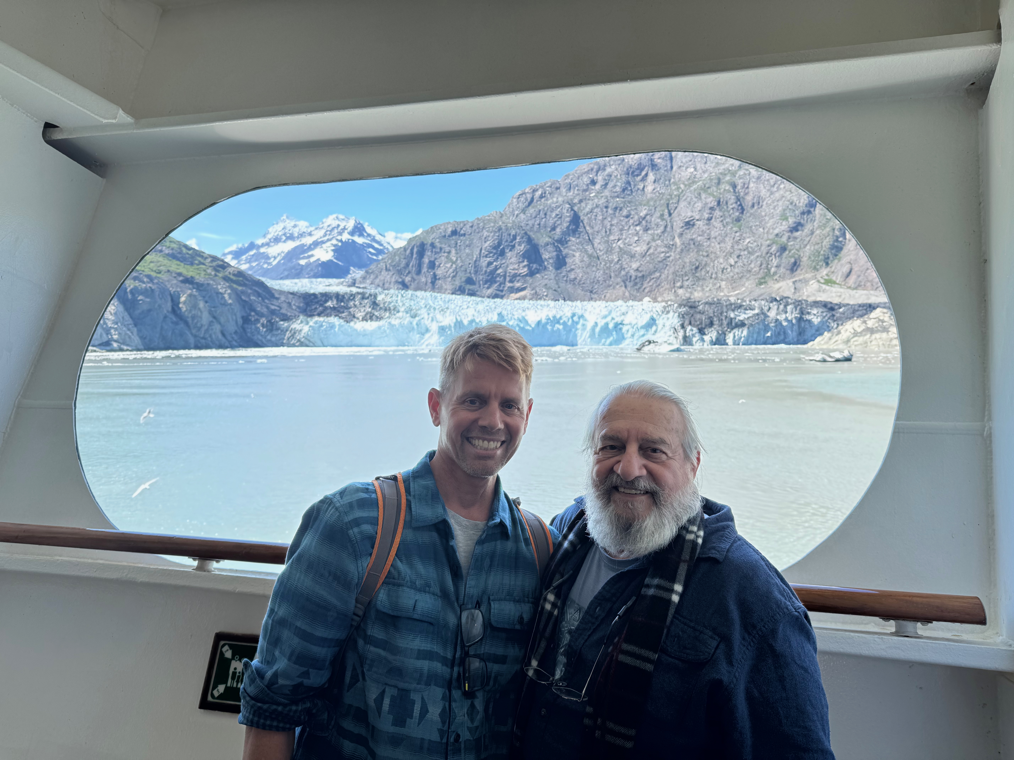
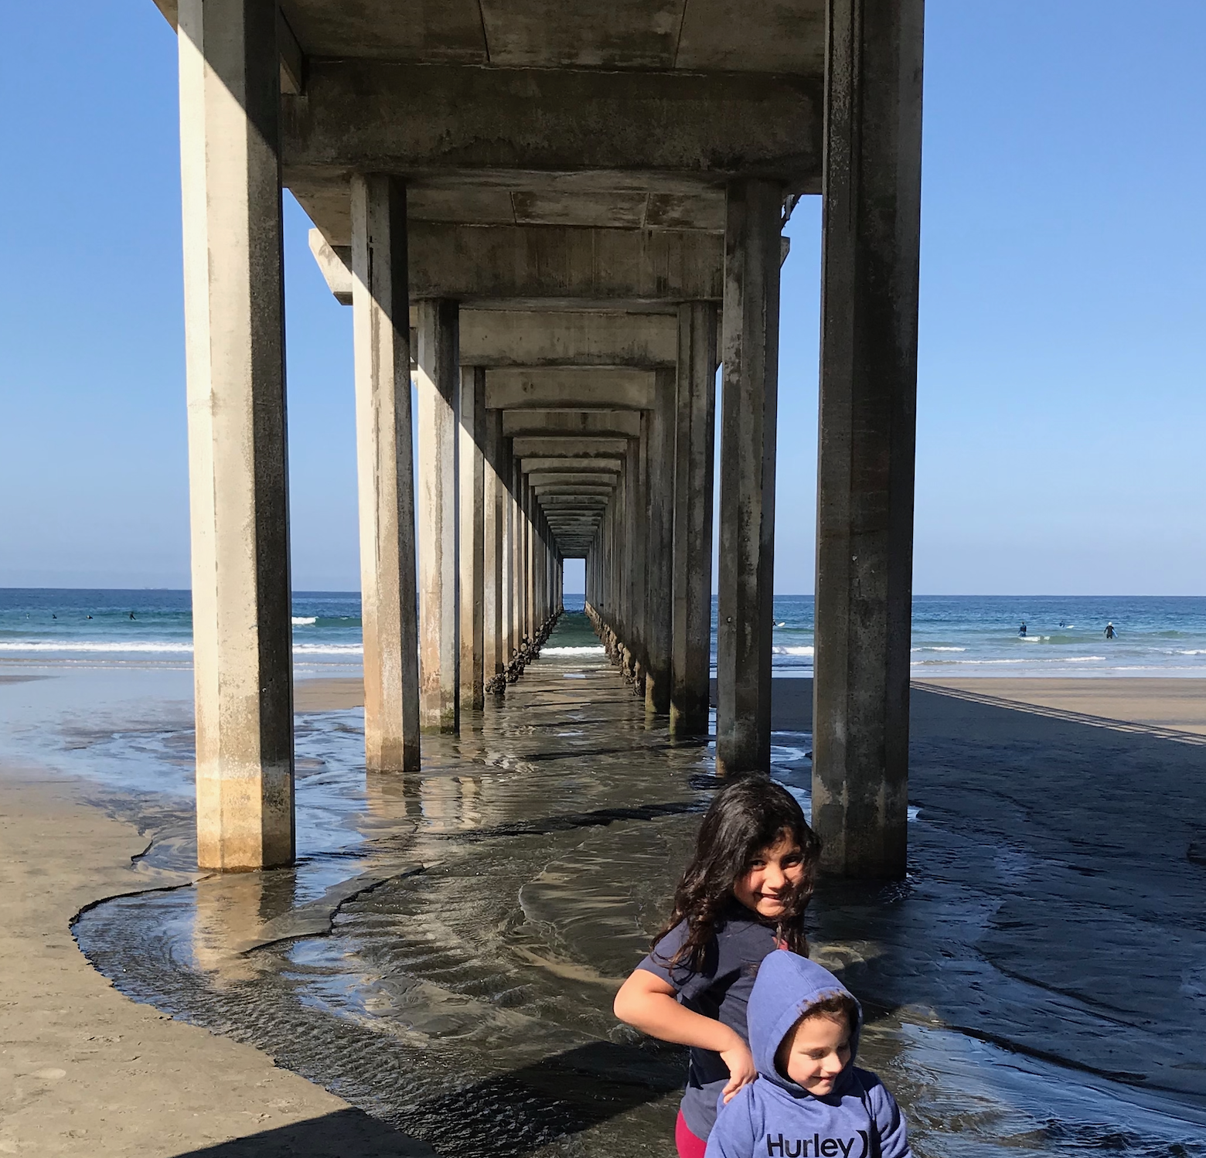
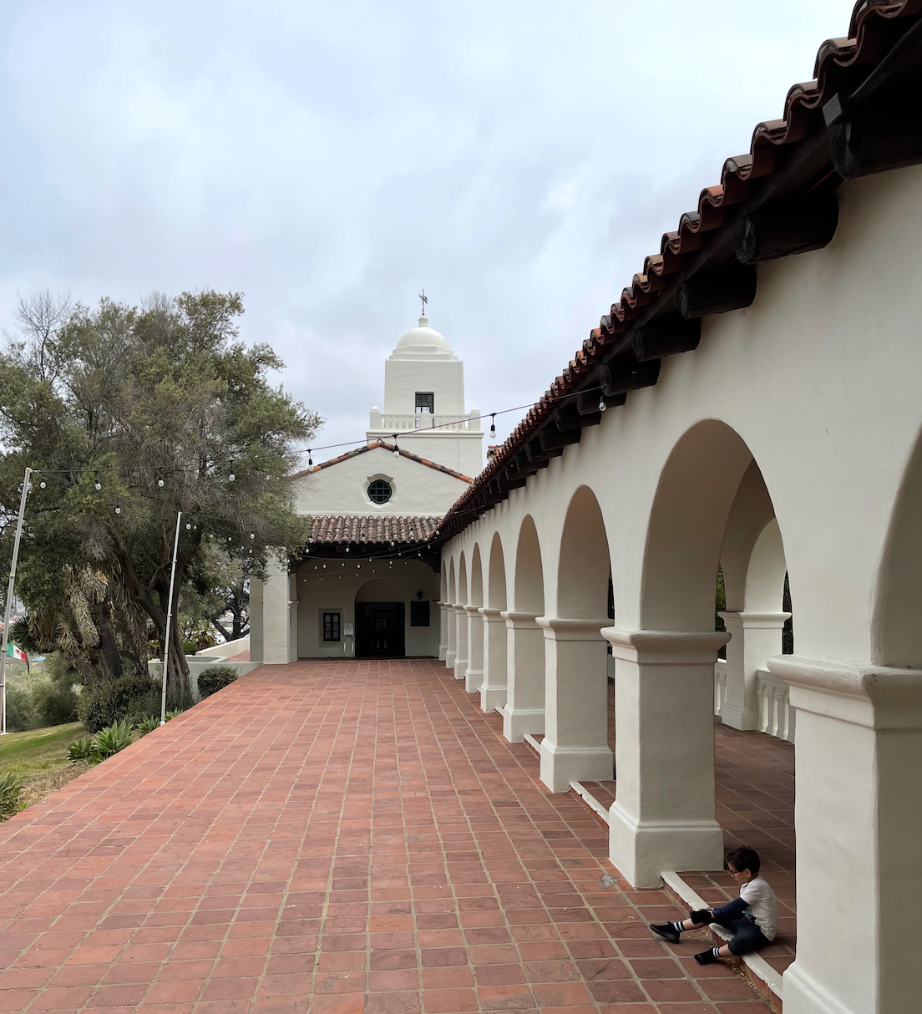

Personal
2

Slide 3
Personal
Personal
Native San Diegan
Home in Tierrasanta
Married for 16 years
Three children at home
Daughter 12, Son 9, Daughter 4
Three grown step-children
Out of the home with 4 grandkids
One Senior Airman at Beal AFB married to an Airman
One married to an Army Sergeant
Interests / Pets / Fun Facts
Garage Network Lab
Enjoy building test Networks at home
Gardening Enjoy growing Native Plants and Cacti
Activities Camping, Hiking, Bodysurfing, Tennis
Pets Desert Tortoise, Small Poodle
Fun Facts
Apollo 11 Moon Launch Date of Birth
Visited Egypt King’s Chamber of Great Pyramid
Marathon Finisher SD Rock N’ Roll 2007, 2010
Summited San Jacinto 10,834 ft Palm Springs
Goal to Summit Mt. Whitney
First Computer IBM PC with two floppy drives
Programmed Basic, Fortran, Pascal in High School
Drove Baja California Cabo San Lucas 2008
3

Slide 4

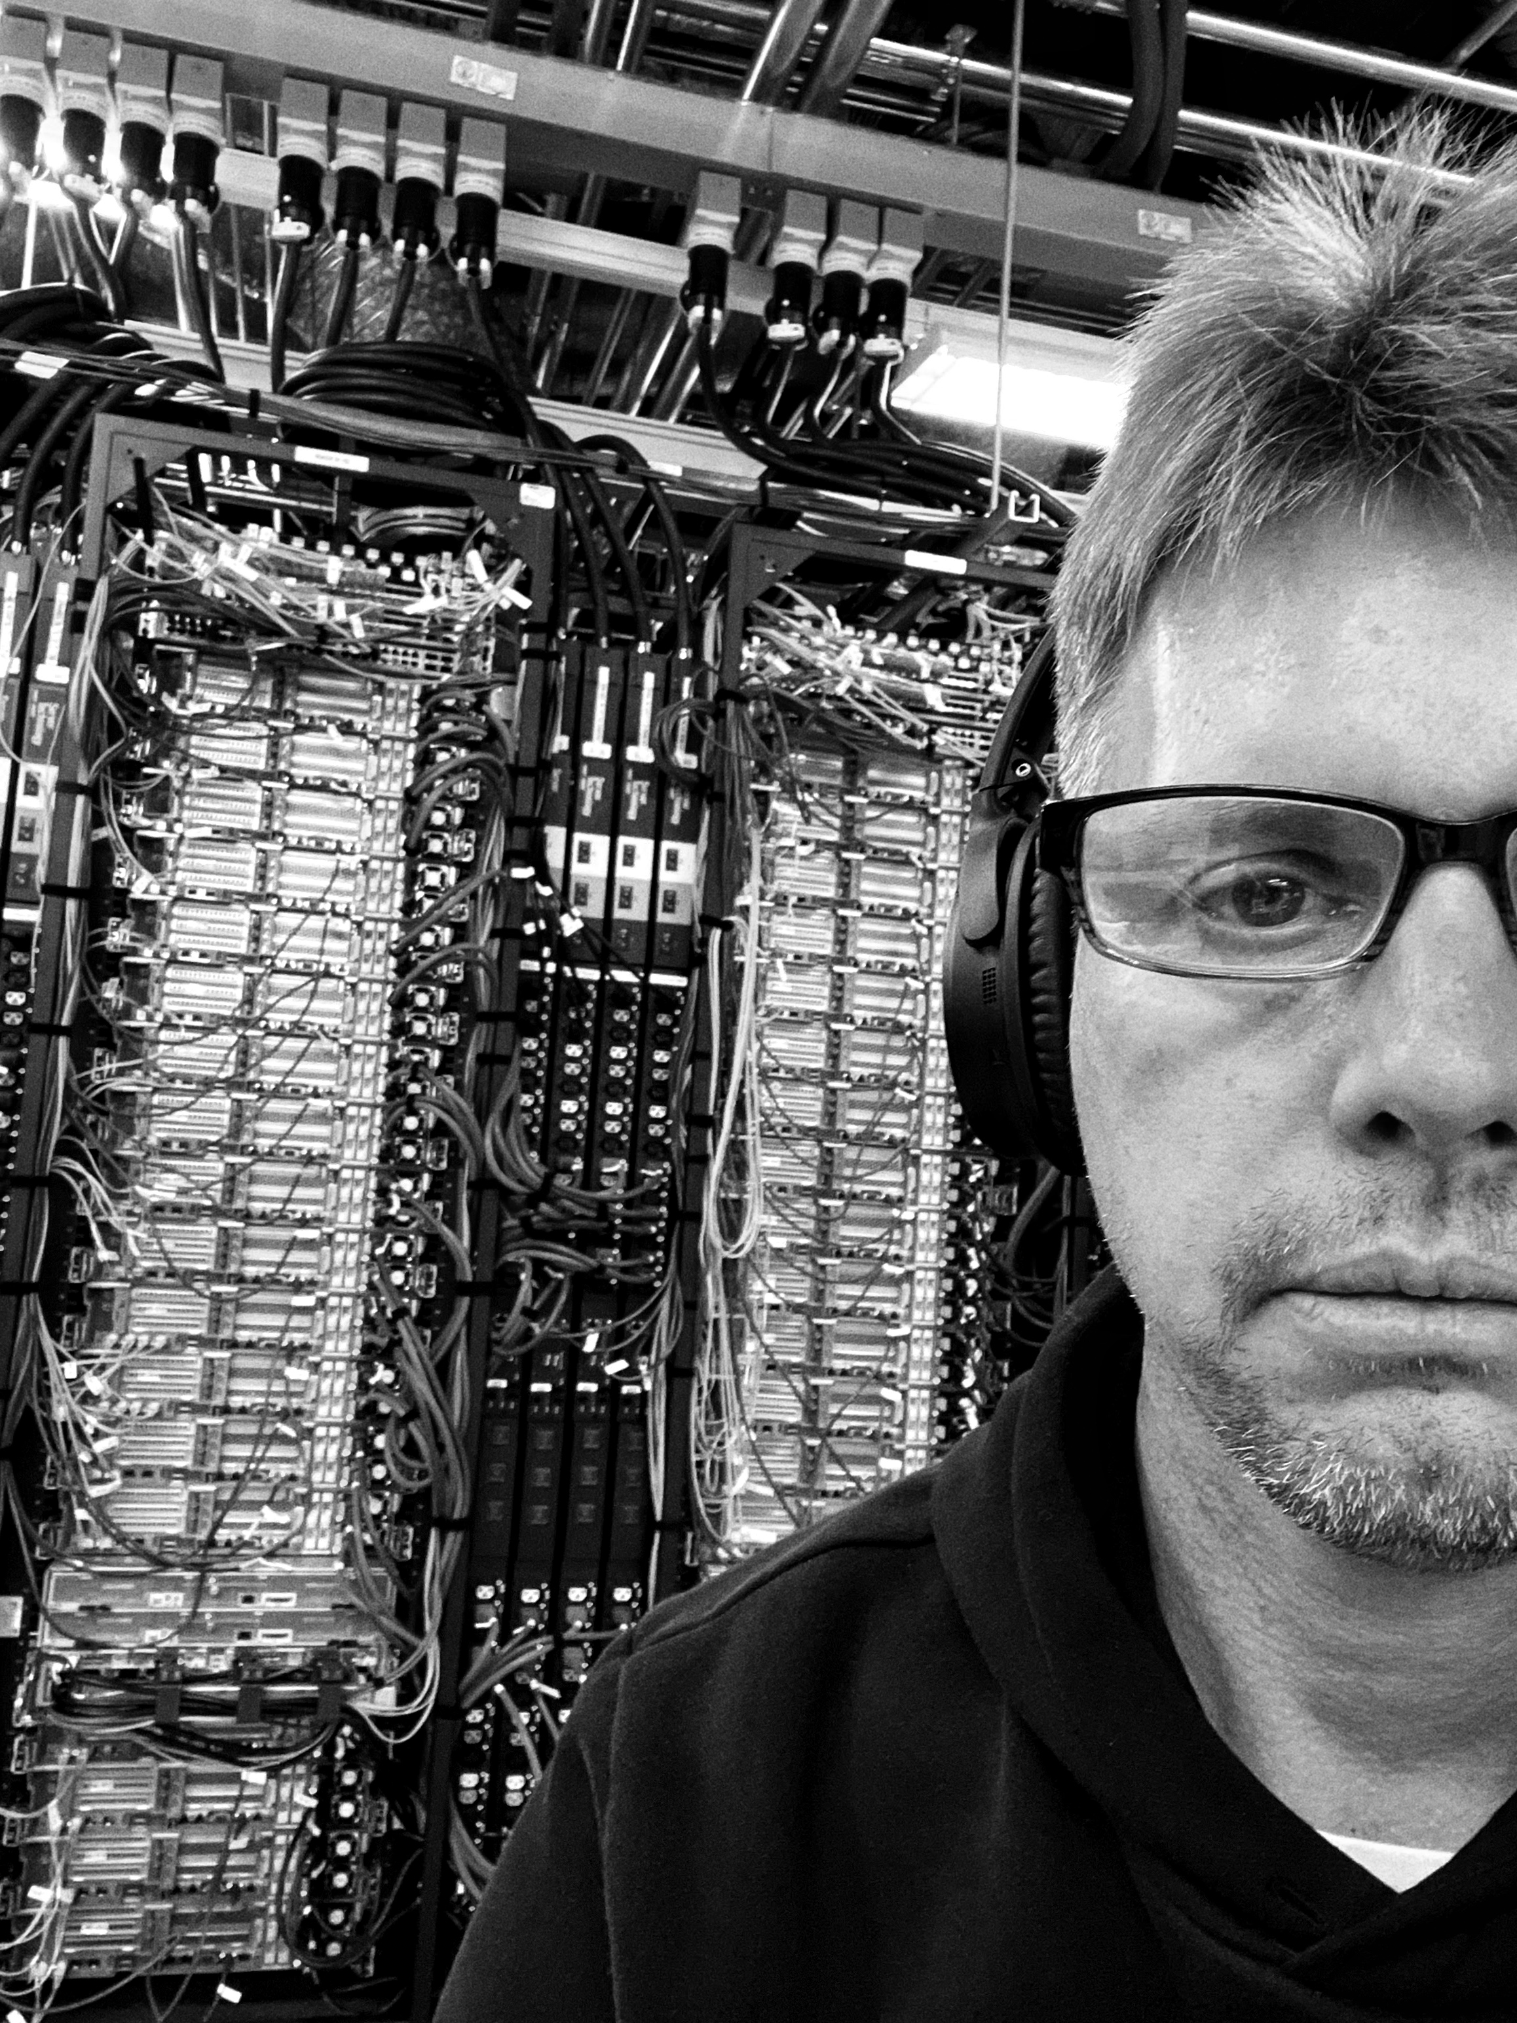
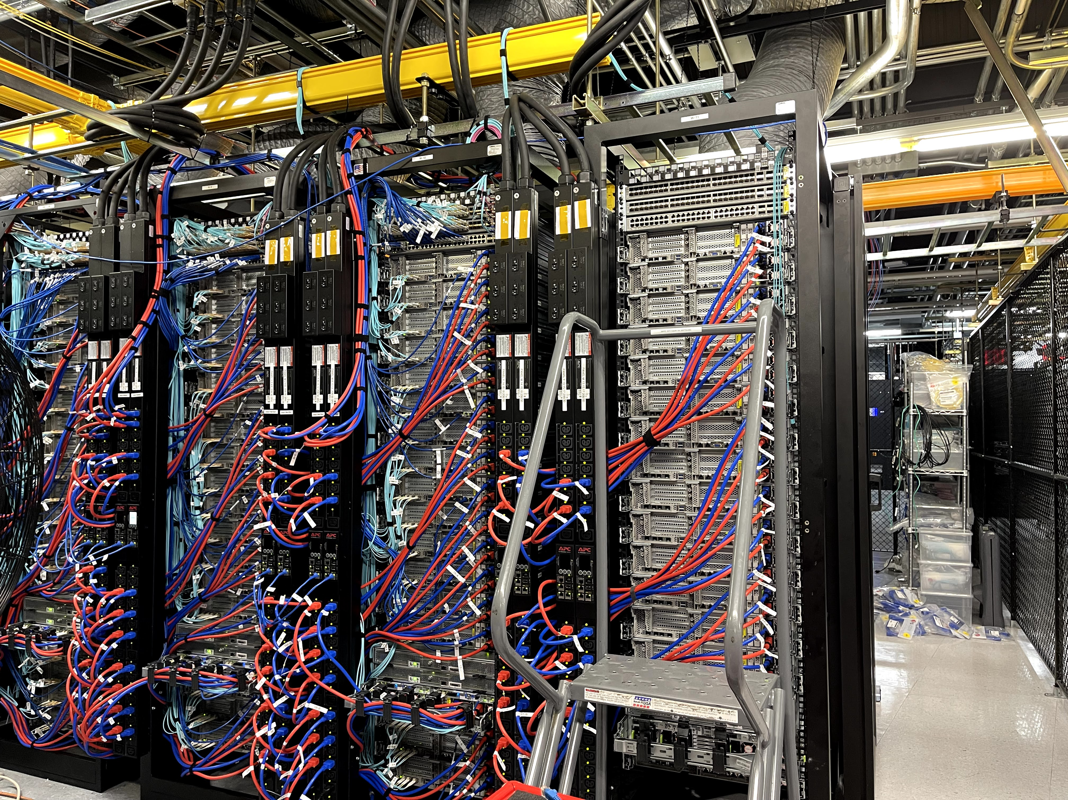
Work
Granter of Network Wishes
4

Slide 5
Work
Education
Pomona College, Cum Laude, 1991
Work Experience 15 Years
Full Spectrum of Network Engineering
* Design and Engineering
* Infrastructure Implementation
* Operations and Troubleshooting
Principal Engineer Datacenter, ISP (M5 Hosting) 2021
SIPR Transport Engineer DoD Contractor 2018-2020
Principal Engineer Datacenter, ISP (CARI.net)
Senior Engineer ISP/VoIP (NextLevel Internet)
Partner Engineer Network Consulting (GoNet Forward)
Junior Engineer ISP/Network Services (Network Insight)
Certifications
CCNP Cisco Certified Network Professional / Past
Security+ / Current
NIWC PAC - Now
IT Specialist / Network Engineer
Joined 4 years ago as Contractor
Civilian Navy since 2023
Branch X
Project X
NIWC PAC - Future
Remain Technical Contributor on Project
Remain in N__ space, but other Network Heavy Projects and Systems
Aiming towards Management of Technical Teams
5

Slide 6
Project Achievements
Fleet Impact
Cybersecurity
Engineered key cybersecurity improvement, meeting Echelon II (Fleet Cyber Command) requirement for Project authorization
Key SME for development and testing of DTRA, CPT, and NSA Red Team cybersecurity test plans for operational system
Network Modernization
Delivered first network monitoring tool
Delivering first network hardware refresh with new routers and switches
New Capabilities
Enabled remote cyber patching to increase patch tempo capability
SME for Secure Joint US/UK Waveform Demo
SME for Project Integrations: PMW 130 CND, NMHS
Fleet Impact (cont.)
Operations
Support Fleet implementations teams
Back-stop troubleshooting of operational issues
Roadmap
Cybersecurity
Continue cybersecurity design improvements: New Firewalls, New CND and IAM services
Network Modernization
Developing new WAN and routing architecture
Additional monitoring and alerting
Developing new virtualization architecture
New Capabilities
Developing Joint Waveform message delivery architecture POC
New integrations
9

Slide 7
Value from Difference
What Differentiates me that provides value to NIWC PAC
Perspective and Gratitude
Appreciation for the History, Prestige, and Mission criticality of the NIWC PAC
Grateful to be part of National Mission oriented enterprise versus commercial
Career Arc Position and Continuity
Tail of Career Arc – I hope and expect to remain with NIWC PAC remainder of career
Continuity provides value - Experience supports improved decision making
Other Qualities
Accept and Enjoy Difficult Challenges
Enjoy working at the edge – Pushing technologies and breaking new ground
Natural Sincerity and Team Orientation
Background rooted in Science - Strong orientation for detail and testing
Imagination - Enjoy conceptualizing new ways of doing things
18

